Slide 1
Project 3 – Texture Classification
Aditya Mulampally
A11816595

Slide 2
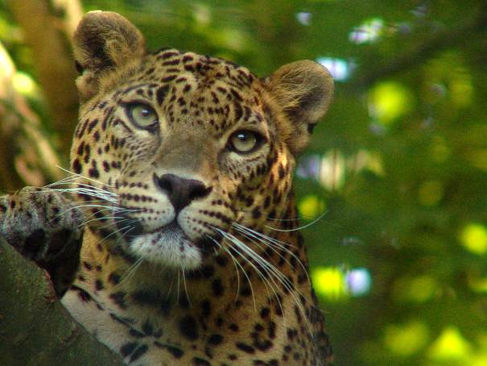
What are textures?
Textures can be defined as a feature that can be used to differentiate between one image from the other.
For example as seen in the picture below, the jaguar has a distinct pattern that can help to identify it.

Slide 3
Why to classify textures?
As textures can be visually similar to the human eye, we need a statistical way to differentiate between the textures.
By classifying the textures we can use the information obtained from them to find and match the new textures we are willing to identify.
The texture analysis algorithms are used to extract features from the images, which can be quantifiably useful to classify textures.

Slide 4
Goal of the project & Methodology followed
The project aims at using the two texture algorithms
Laplacian Pyramid
Gabor Filter to identify the feature vectors of each of the 59 textures given, and use the cropped versions of the image to identify if we can trace it back to the original texture.
Both the classification algorithms have two steps, the training phase and the recognition phase. Both the phases will be discussed for each algorithm.

Slide 5
Laplacian Pyramid based texture classification
Training Stage
The training stage for this stage involves the formation of the gaussian pyramid.
The pyramid’s layers are obtained by convoluting a gaussian kernel on the image and then down sampling it.
Then the Laplacian pyramid is formed by up sampling the subsequent layer and subtracting with the current layer of the gaussian pyramid.
Each of this layer is worked upon with a specific statistical method and is part of the feature vector.
Other statistical methods are used on the same layer of the pyramid to form the complete feature vector.
The statistical methods used are: mean, variance, standard deviation, skewness and kurtosis.
This procedure is repeated on all available textures to form the texture bank.

Slide 6
Laplacian Pyramid based texture classification
Detection Stage
For the detection stage the texture images are divided into many parts, in an attempt to identify from where the texture is from.
The smaller images undergo the same process of feature vector formation.
We can use the feature vectors as a identification map for each texture.
In an ideal case each of the smaller textures' feature vectors will be identical to the source texture.
But practically the feature vectors are not always same and hence we need to vary the input parameters of the algorithm, such that we can obtain better recognition rate.

Slide 7
Gabor Filter Classification
The Gabor filter is based on using the various Gabor filter bank constituents on a specific texture to obtain their signatures.
As similar to the Laplacian method, these signatures have been used to create the feature vector by applying the following statistics: Mean, Variance, Standard Deviation, Skewness and kurtosis.
These are the constituents of the Gabor filter bank.
This concludes the learning stage.

Slide 8
Gabor Filter Bank
In the detection stage, the same method is used to test the effectiveness of the classification algorithm.
The original textures are divided into many parts for which the previously said feature vectors are computed.
These are used to compute the level of similarity to the original texture, to see if our classification algorithm has worked or not.

Slide 9
Result Discussion – Laplacian Pyramid Classification
I have obtained a best detection percentage of 78.28%. (Over all average)
I have constructed a table which shows the different results I have obtained.
Sigma | Kernel Size | Number of layers | Mean | Variance | Skewness | Kurtosis | Std. Deviation | Overall Avg. %
0.25 | 5 | 4 | Used | Used |  | Used |  | 52.35
0.37 | 3 | 4 | Used | Used | Used | Used | Used | 78.29
0.45 | 5 | 4 |  | Used |  | Used |  | 74.30
1.5 | 3 | 4 |  |  | Used |  | Used | 66.71

Slide 10
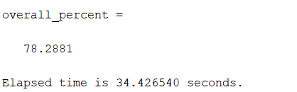
Result Discussion – Laplacian Pyramid Classification
These are only some of the results I have shown in the table.
I have found that I have obtained better results when the number of pyramid layers and the kernel size used are 4 and 3 respectively.
I have also experimented with different interpolation of down/up sampling such as “nearest neighbors”, ”bilinear interpolation”, “bicubic interpolation” and I found that bilinear interpolation works the best.
I have tried the use of both Euclidian as well as Manhattan distance and found that Euclidian distance gives the better results
The runtime of the program is given as:

Slide 11
Result Discussion – Gabor Filter
I have obtained a best result of 81.07 % using the Gabor Filter method.
I have constructed a table which shows the different results I have obtained.
Num Scales | Num Orientations | Mean | Variance | Skewness | Kurtosis | Std Deviation | sigmaOnf | dTethaonsigma | Overall Avg %
4 | 6 |  | Used |  |  | Used | 0.65 | 1.5 | 81.067
4 | 6 | Used | Used | Used | Used | Used | 0.65 | 1.5 | 55.56
4 | 6 | Used |  |  | Used |  | 0.55 | 1.5 | 68.59
4 | 6 |  | Used |  |  | Used | 0.55 | 1.5 | 79.56

Slide 12
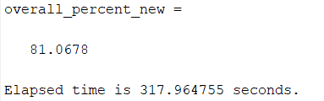
Result Discussion – Gabor Filter
This type of classification was really computationally intensive and took a long time to obtain results even if the new code was run instead of computing everything again.
I have found that here using only variance and standard deviation gave the best results.
I have tried the use of both Euclidian as well as Manhattan distance and found that Euclidian distance gives the better results
The run time of this method is very long , and I have also observed a longest of 13 minutes when all the statistics are used.

Slide 13
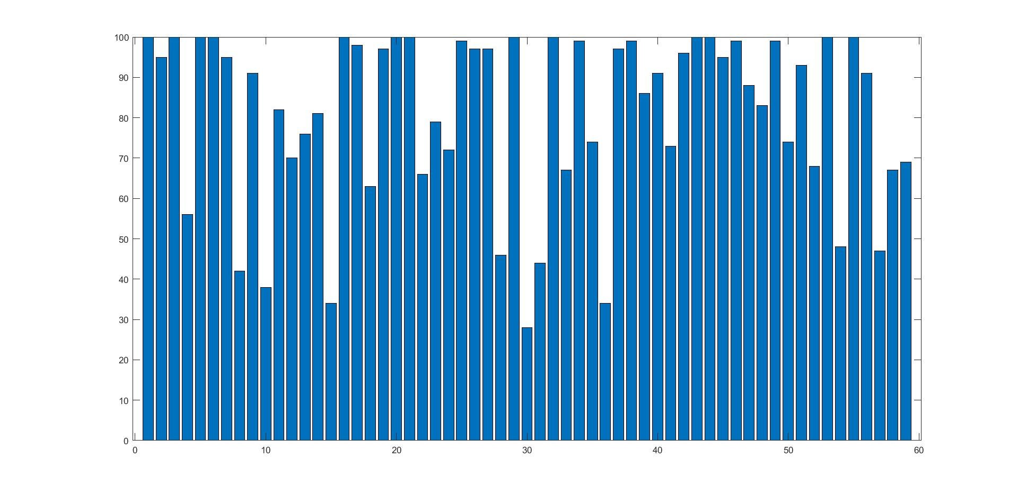
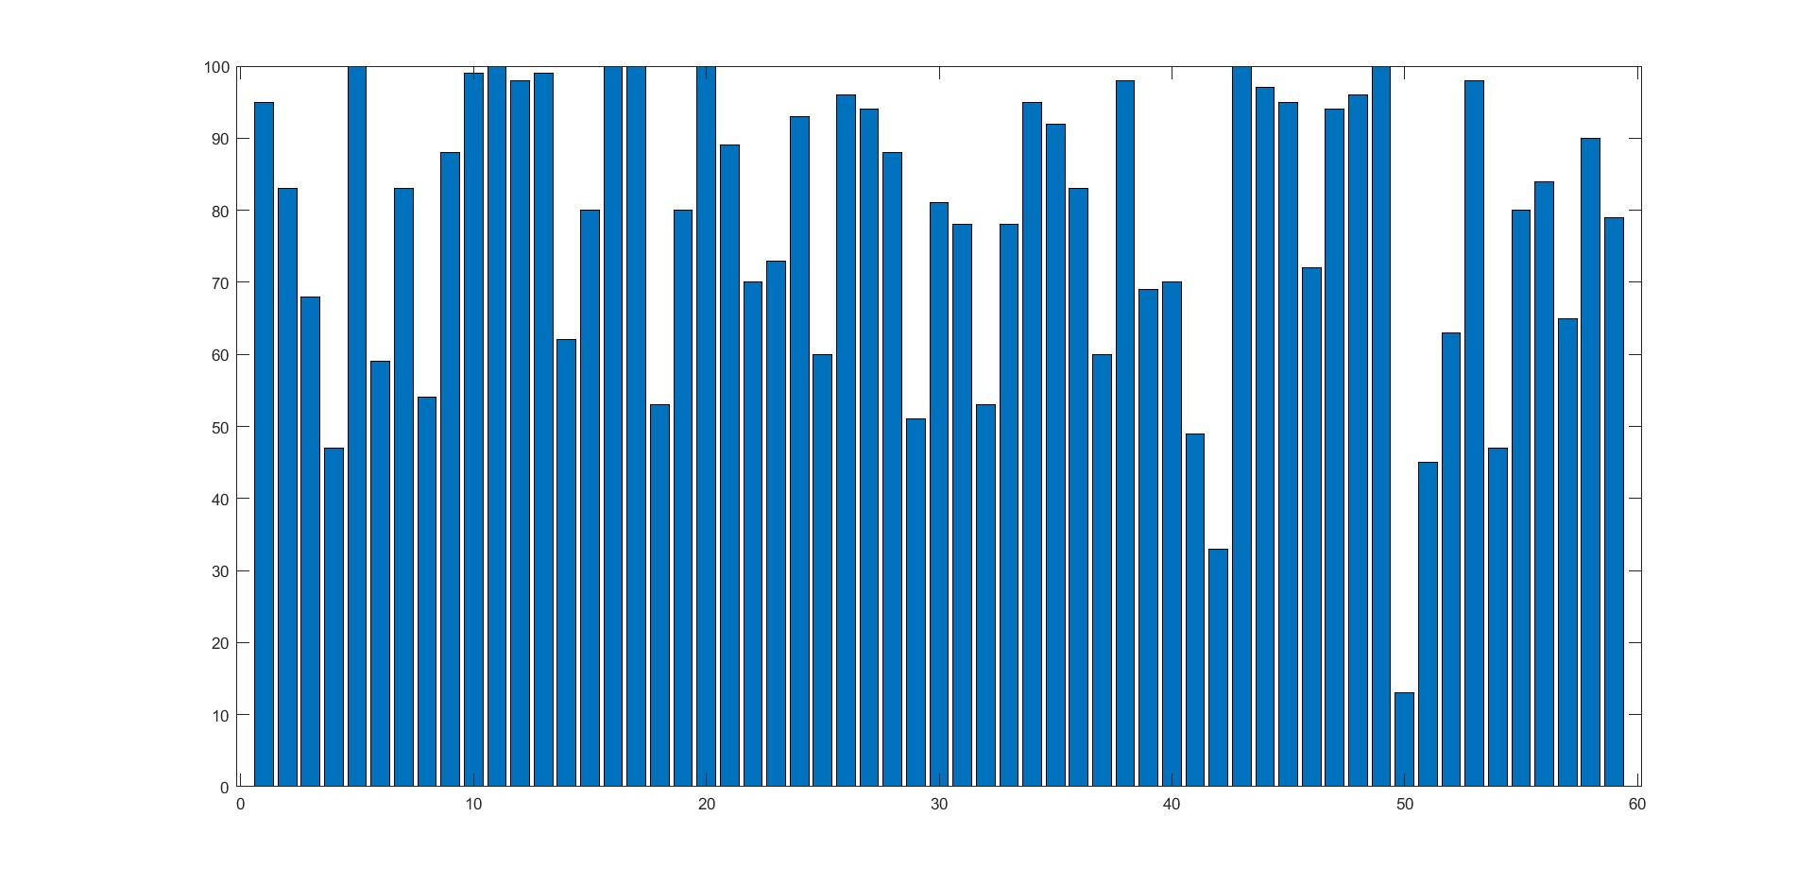
Comparison and Misclassification
Bar chart of each detection of Gabor
Bar chart of each detection of Laplacian

Slide 14
Comparison and Misclassification
I have observed that some of the textures which have not been classified well in the Laplacian do better on the Gabor filter.
This is not true in all the cases as few texture numbers such as ’11 22 13 59’ performs better on the Laplacian method.
The worst performance of the gabor filter is 28% on the texture number 30 as opposed to 81% on the same texture on the Laplacian method.
The worst performance of the Laplacian filter is 13% on texture 50, for which the gabor filter performed with 74% positive detection

Slide 15
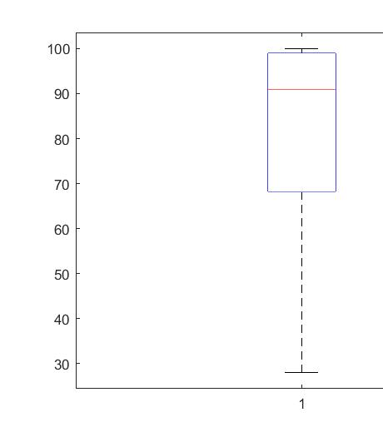
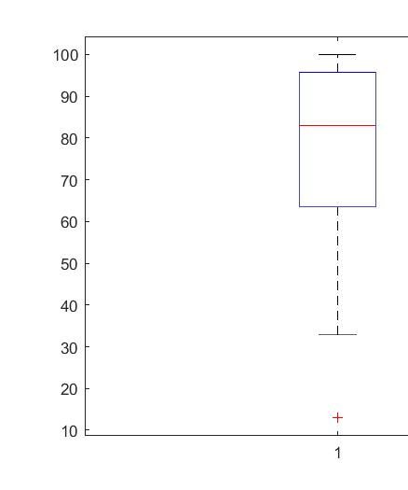
Comparison
This is a box plot of both the methods with input data as the percentage of correct classification of each image.
Here we can see a box plot of both the filters side by side, we can observe that the Gabor filter has better results on the median of the entire data has a higher percentage of correct classification.
Gabor Box Plot
Laplacian Box Plot

